Slide 1
Retail Sales Optimization Project
Made by: KASHISH SACHDEVA
Interim ID:INT00469

Slide 2
Project Overview
The primary objective of the Retail Sales Project was to conduct a comprehensive analysis of sales, customer, and inventory data in order to uncover meaningful insights into purchasing patterns, seasonal trends, and customer preferences. This involved identifying high-performing and underperforming products, understanding the buying behavior of different customer segments, and evaluating inventory turnover rates. The ultimate goal was to leverage these insights to improve stock management strategies, reduce overstock and stockouts, and enhance product recommendations to drive customer satisfaction, increase revenue, and support data-driven decision-making for future business growth.

Slide 3
Dataset Overview
Total Records:
Key Features:
Invoice Number: Unique identifier for each transaction
Customer ID: Unique identifier for each customer
Gender: Gender of the customer
Age: Age of the customer
Category: Product category purchased
Quantity: Number of items purchased
Price: Unit price of the product
Payment Method: Mode of payment (e.g., cash, credit card, e-wallet)
Invoice Date: Date of transaction
Shopping Mall: Location of the store
Project Focus (Target Analysis): Analyzed the dataset to:
Identify sales trends across time periods, customer segments, and product categories
Understand customer behavior such as purchasing frequency, preferences, and demographics
Optimize inventory management by detecting fast/slow-moving items and seasonal demand
Provide actionable insights and product recommendations to enhance customer experience and maximize revenue

Slide 4
Tools and Technologies Used
Programming: Python, SQL
Libraries & Tools: Pandas, NumPy, Matplotlib, Seaborn
BI Tools: Power BI
Spreadsheet Analysis: Microsoft Excel

Slide 5
Data Cleaning and Preprocessing
Handled missing values Encoded categorial features
Detected outliers
Normalized data
Handle Duplicates
Data Type Conversion Standardize Column Names

Slide 6
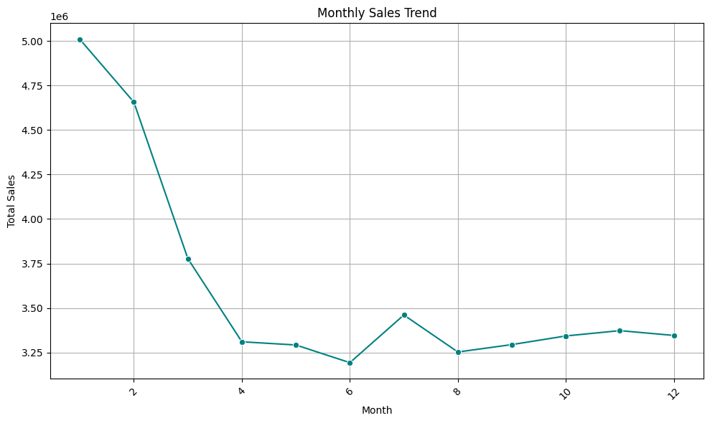

Slide 7
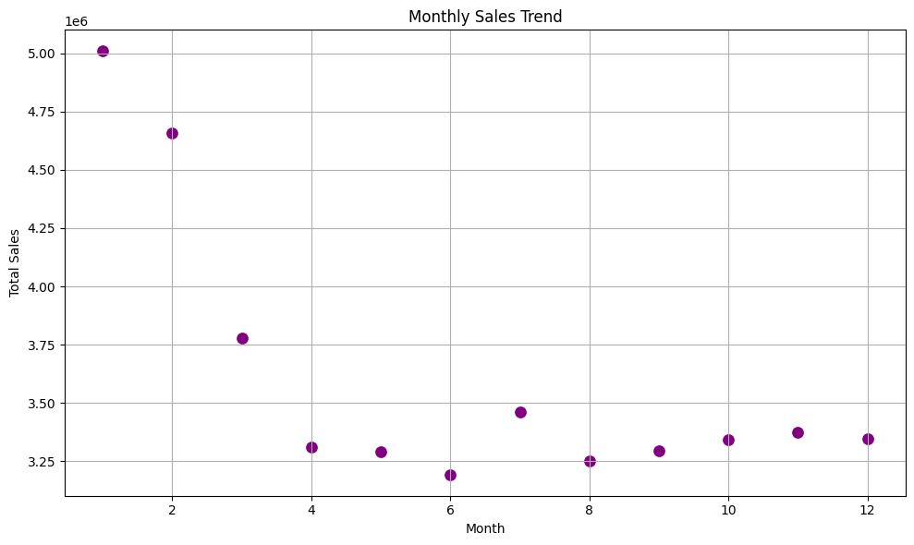

Slide 8
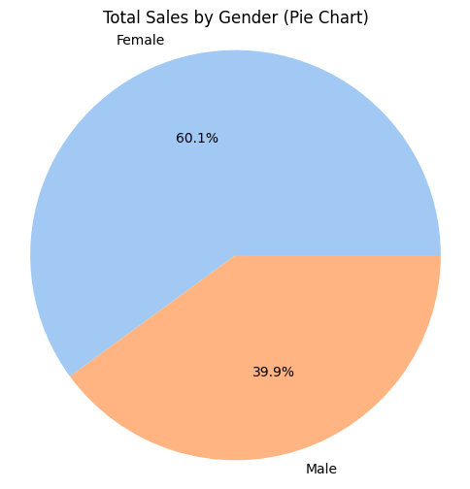

Slide 9
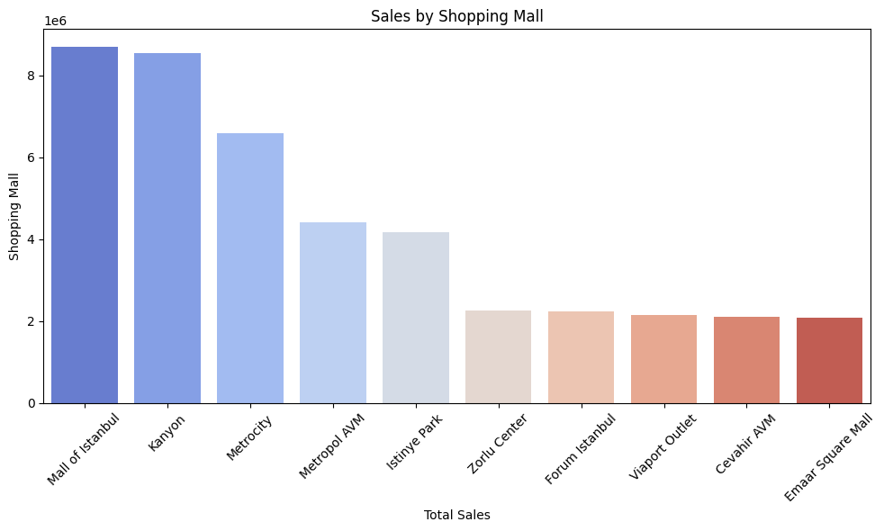

Slide 10
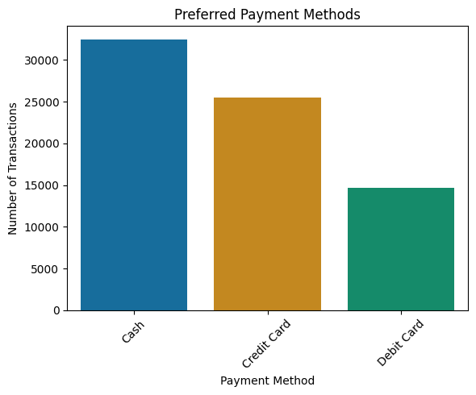

Slide 11
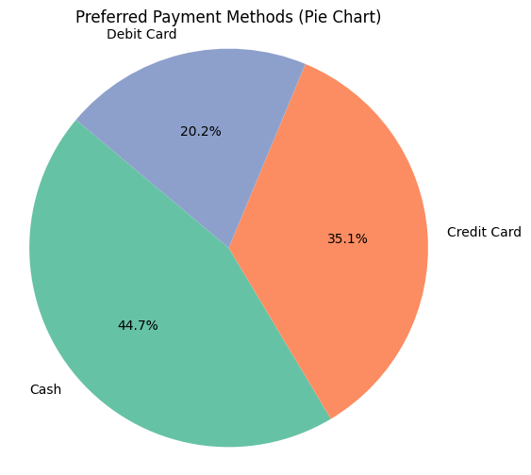

Slide 12
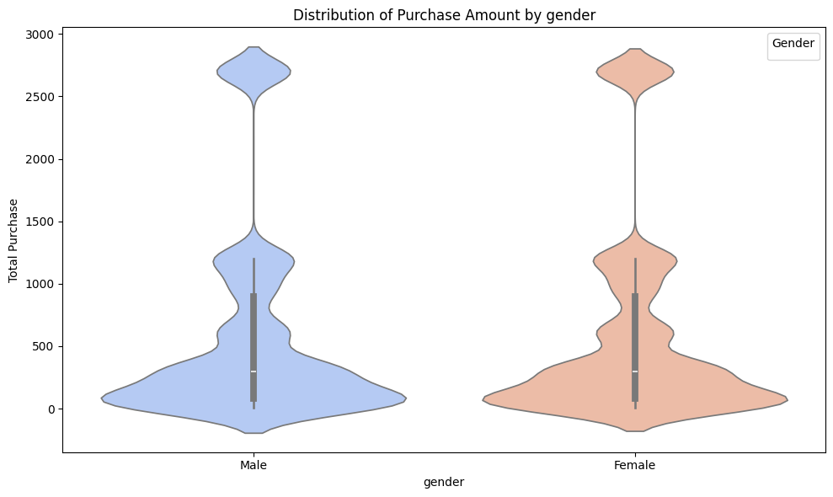

Slide 13
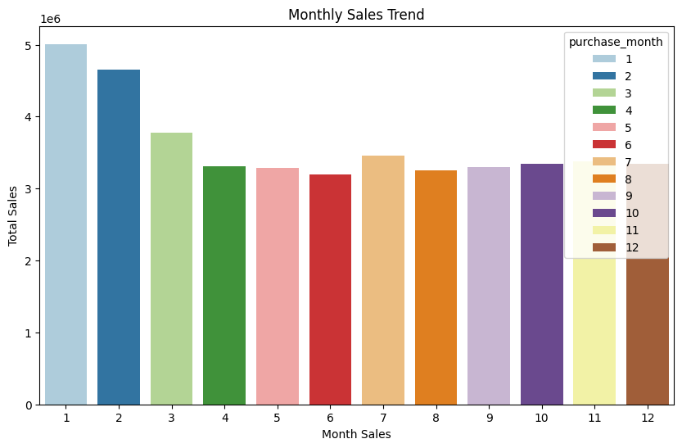

Slide 14
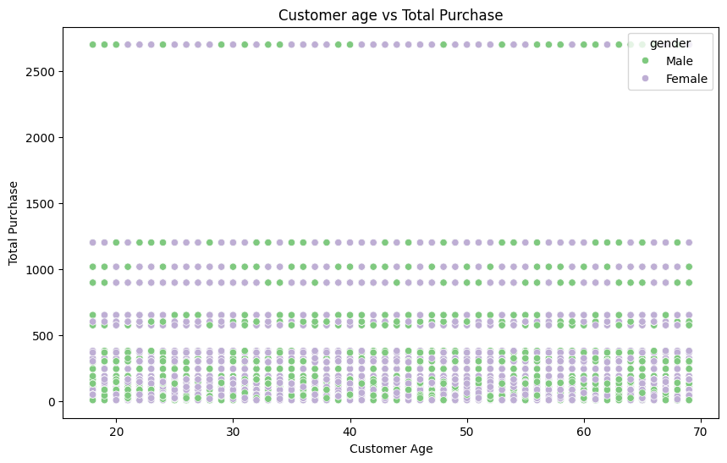

Slide 15
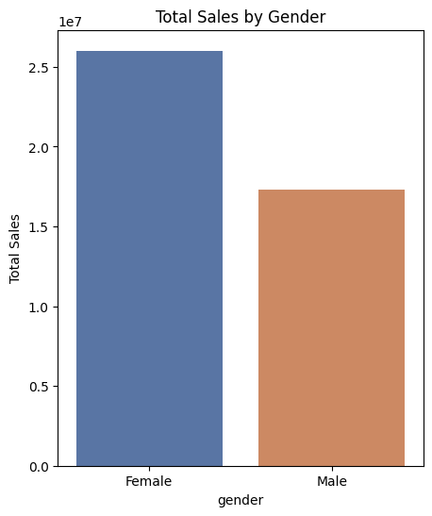

Slide 16
Business Insights
High Female Contribution to Sales:
Females contribute to 60.1% of total sales, significantly higher than males (39.9%).
Average purchase distribution and frequency are also slightly higher for female customers.
Top Performing Shopping Malls:
Mall of Istanbul and Kanyon are the best-performing malls in terms of sales.
Emaar Square Mall, Cevahir AVM, and Via Port Outlet are the lowest performing.
Preferred Payment Methods:
Cash is the most used method (44.7%), followed by Credit Card (35.1%), and Debit Card (20.2%).
Seasonal Sales Trend:
Sales are highest in January and February, followed by March.
Mid-year (June–August) sees a moderate recovery, while December has the lowest sales.
Age-Based Customer Spending:
The 25–35 age group makes up the majority of purchases.
Customers aged 20–45 show more consistent and higher purchasing behavior.

Slide 17
Recommendations
Target Female Customers More Effectively:
Launch female-oriented campaigns and bundles in top categories, especially in high-performing malls.
Improve Performance of Low-Selling Malls:
Conduct local promotions or events at Emaar Square Mall, Cevahir AVM, and ViaPort Outlet to boost footfall.
Boost Stock Before Peak Months (Jan–Feb):
Optimize inventory levels in Q4 to prepare for increased sales in Q1 (Jan–Mar).
Launch Age-Specific Promotions (25–35 Age Group):
Introduce personalized deals, loyalty programs, or discounts specifically for the 25–35 demographic.
Encourage Digital Payments:
Offer incentives for Credit and Debit Card use to reduce cash dependency and improve transaction tracking.
Product Recommendations Based on Gender Patterns:
Analyze popular product categories by gender and apply machine learning or rule-based logic for smart product recommendations.

Slide 18
Thankyou
Made by: Kashish Sachdeva
INT00469

